Slide 1

Social Networks
Competent Jerks, Lovable Fools, and the Formation of Social Networks
  https://hbr.org/2005/06/competent-jerks-lovable-fools-and-the-formation-of-social-networks

Slide 2
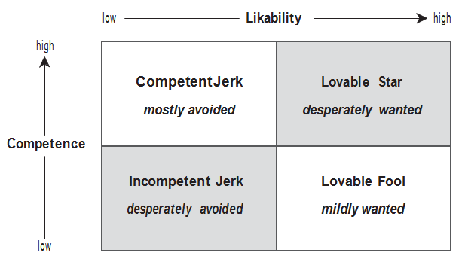
Social Networks

Slide 3
Social Networks
Competent Jerks:
  Nobody likes them, but they’re good at job
Lovable Fools:
  Very likable, but not good at work
Ideally want lovable + competent

Slide 4
Social Networks
Manufacture Liking
  Create opportunities for staff to bond
Leverage the Likable
  Use them to engage detractors
Work on the Jerk
  Reward good behaviors, coaching / socialize them

